Slide 1



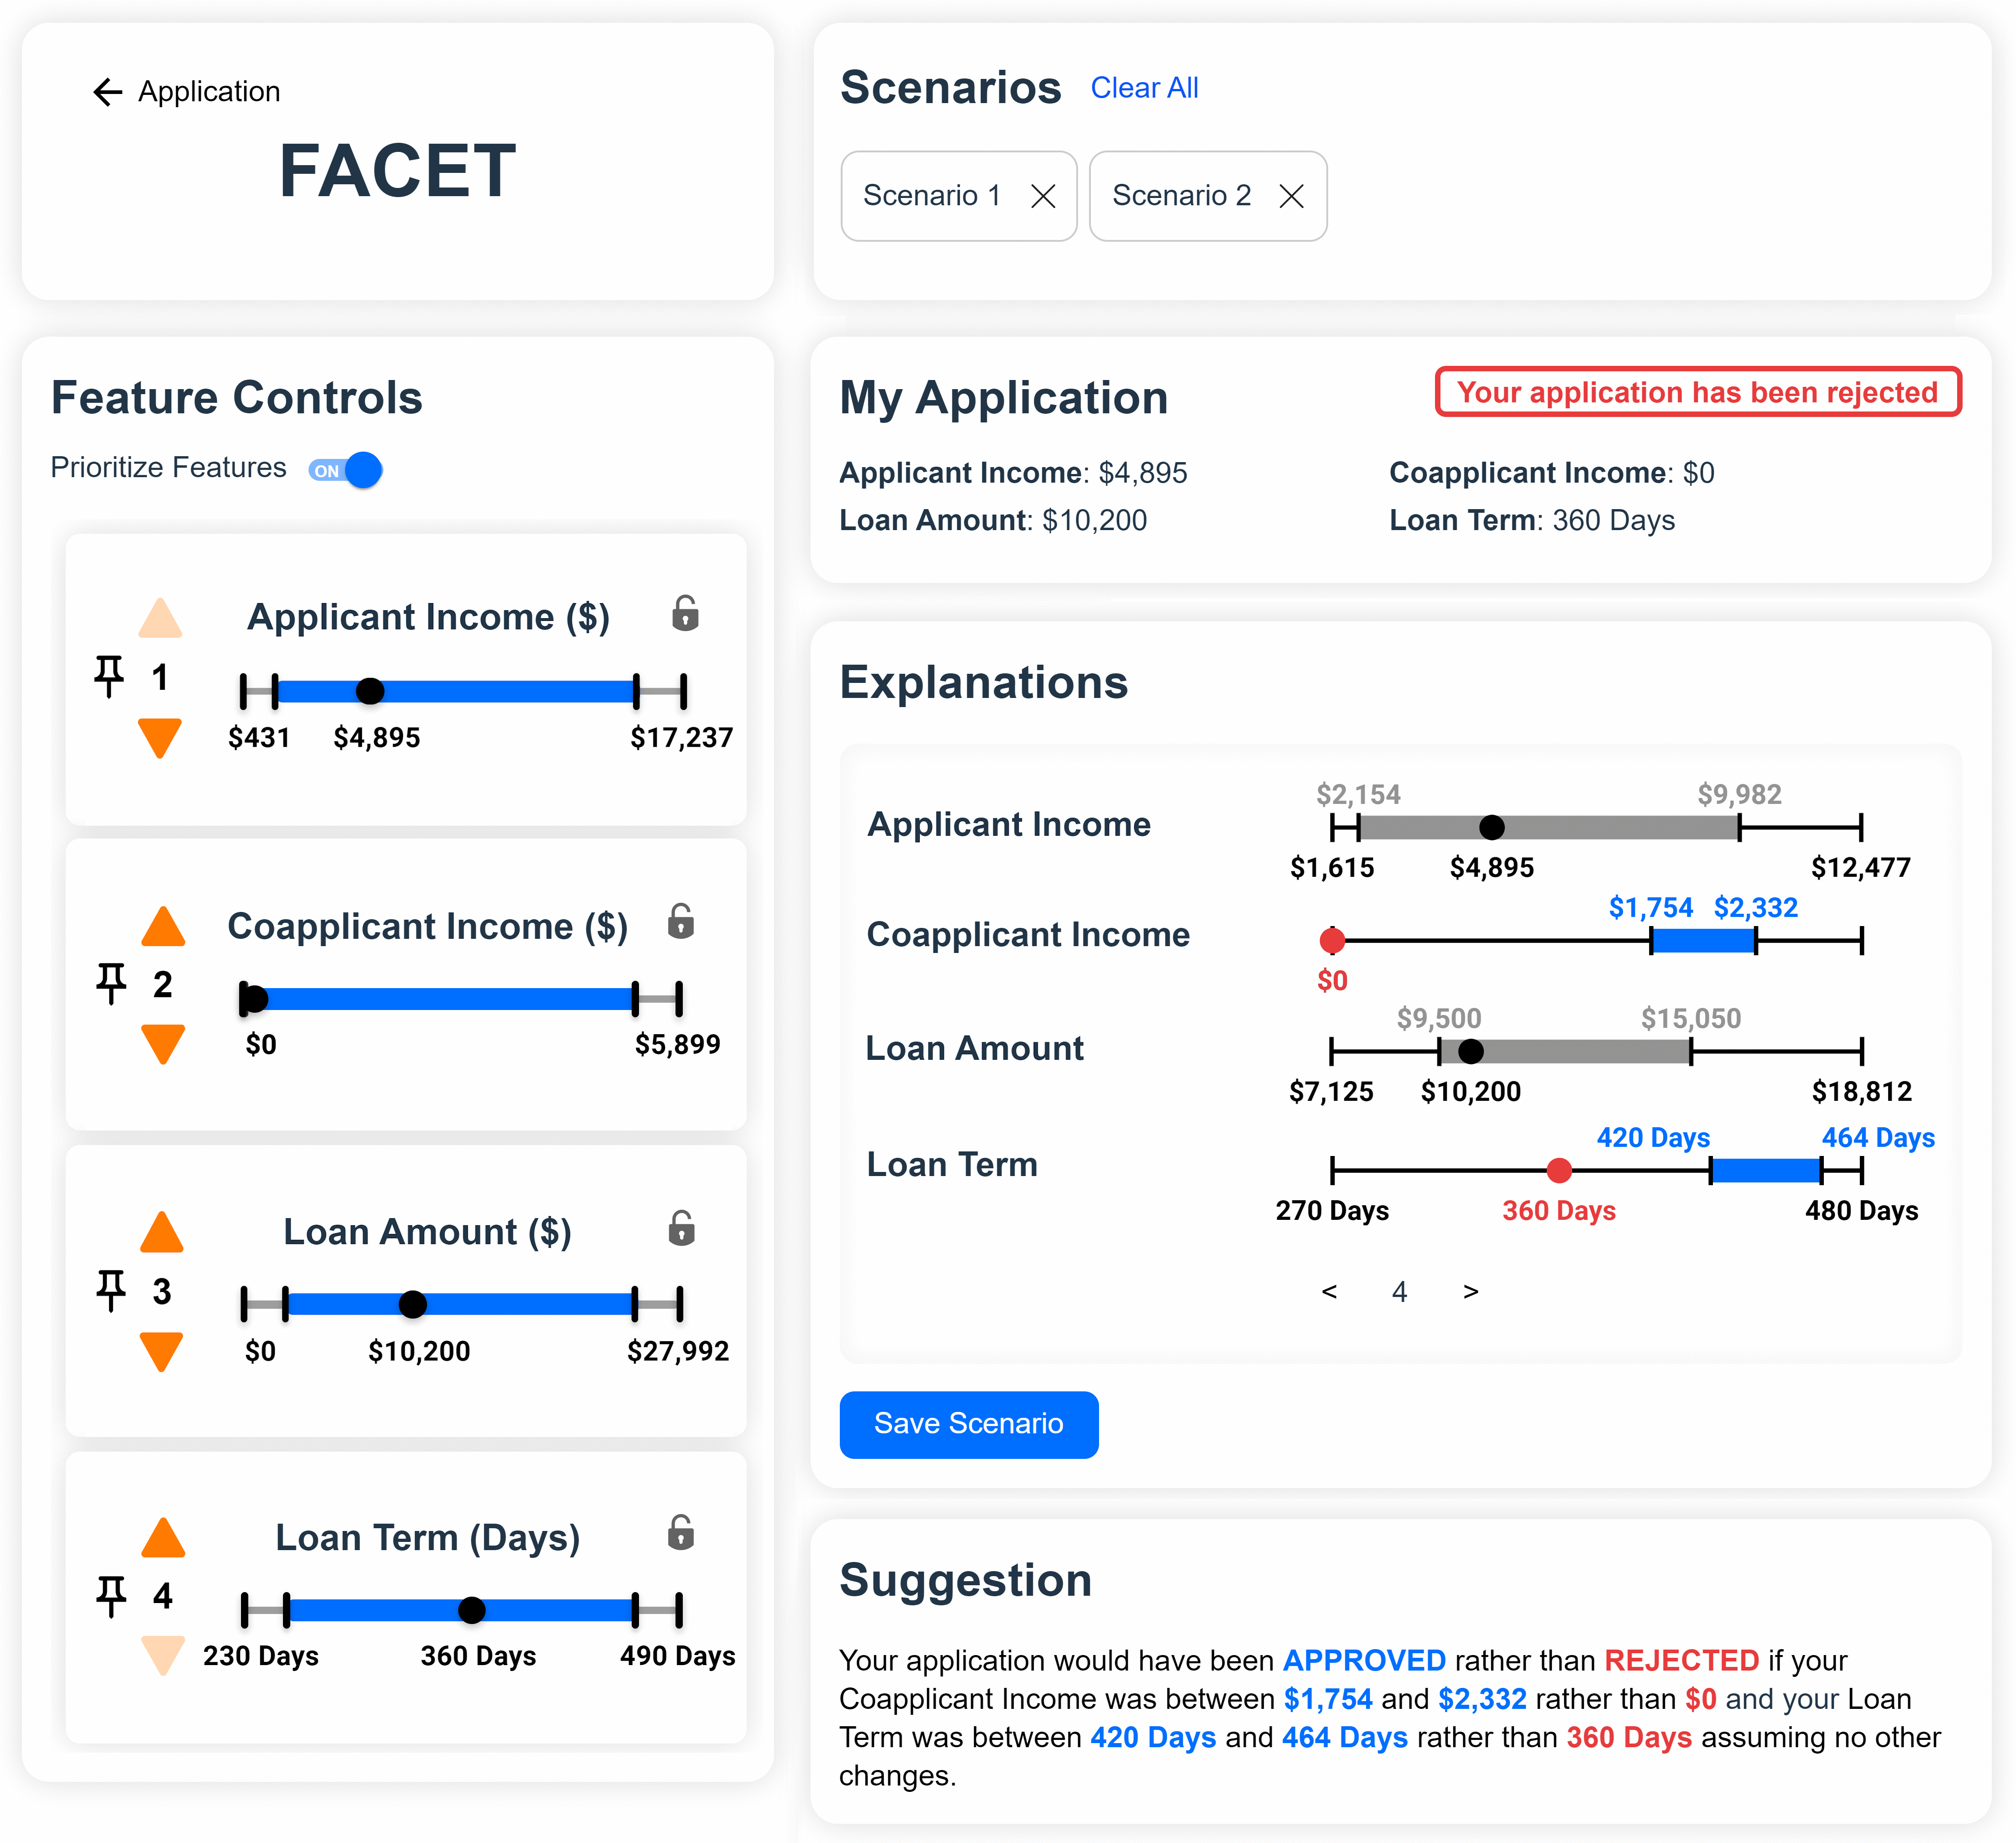





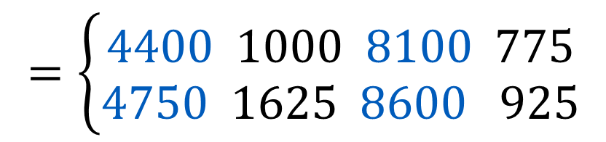


Visual interactions let lay users explore and compare explanations of ML decisions
Counterfactual Explanation Analytics: Empowering Lay Users to Take Action Against Consequential Automated Decisions
Peter M. VanNostrand, Dennis M. Hofmann, Lei Ma, Belisha Genin, Randy Huang, and Elke A. Rundensteiner
Background: Machine learning is used in domains like finance, hiring, and law to make decisions that can strongly affect people’s lives. Counterfactual explanation systems suggest changes that help users avoid negative outcomes.
I’d like to apply for a loan Here’s my financial info
Your application is
REJECTED
REJECTED
Reject
Income | Rent | Savings | Debt
$4,000 | $1,500 | $7,000 | $850
Accept
Why? What can I do
to get ACCEPTED?
No idea, that’s just
what the machine said
ACCEPTED
Income | Rent | Savings | Debt
$6,000 | $1,500 | $7,000 | $850
Challenge 1: A counterfactual explanation may satisfy one user but not another – explanations must be personalized
Challenge 2: Users can’t match an explanation exactly, leaving their true outcomes unknown
Unalterable Features
Feature Restrictions
Feature Priorities
My boss won’t give
me a raise
Apartments near me cost $2-$3k
I’d rather wait and save money
Total Savings
?
$7,001
$7,000
?
$6,999
Solution 1: Generate and index diverse explanation candidates,
let users explore explanations by querying with actionable criteria
FACET Dashboard: A visual paradigm for querying and presenting counterfactual region explanations
Classifier
XAI System
Income | Rent | Savings | Debt
$6,000 | $1,500 | $7,000 | $850
SELECT TOP-EXPLANATIONS(K)
WITH WHAT-IF SPECULATION:
Income < $5,000
WITH UNALTERED FEATURES:
Gender, Rent
ORDER BY DISTANCE(X) WITH WEIGHT W
User Knowledge
Income | Rent | Savings | Debt
$4,500 | $1,500 | $8,500 | $850
Solution 2: Create Counterfactual Regions that are robust to expected changes and provide context for possible variations
Reject
Income
Rent
Sav.
Debt
Accept
$$=\left\{\begin{aligned}4400 1000 8100 775 \\ 4750 1625 8600 925\end{aligned}\right.$$
lower bounds
$$R$$
upper bounds
$$R$$
$$\$4,400≤income≤\$4,750$$
Check out our paper for code and more info!
Peter M. VanNostrand | PhD Candidate
Department of Data Science, Worcester Polytechnic Institute

